Slide 1
SubNetting & SuperNetting

Slide 2
What is subnetting?
Subnetting is the breakage of big networks into smaller network in order to avoid large traffic over the networks.
A Subnet mask is a 32-bit number that masks an IP address, and divides the IP address into network address and host address. Subnet Mask is made by setting network bits to all "1"s and setting host bits to all "0"s. Within a given network, two host addresses are reserved for special purpose, and cannot be assigned to hosts. The "0" address is assigned a network address and "255" is assigned to a broadcast address, and they cannot be assigned to hosts.

Slide 3
It is basically the act of dividing a network into smaller logical subnetworks.
For examples:
IP Address : 192.168.100.240
Subnet Mask : 255.255.255.0

Slide 4
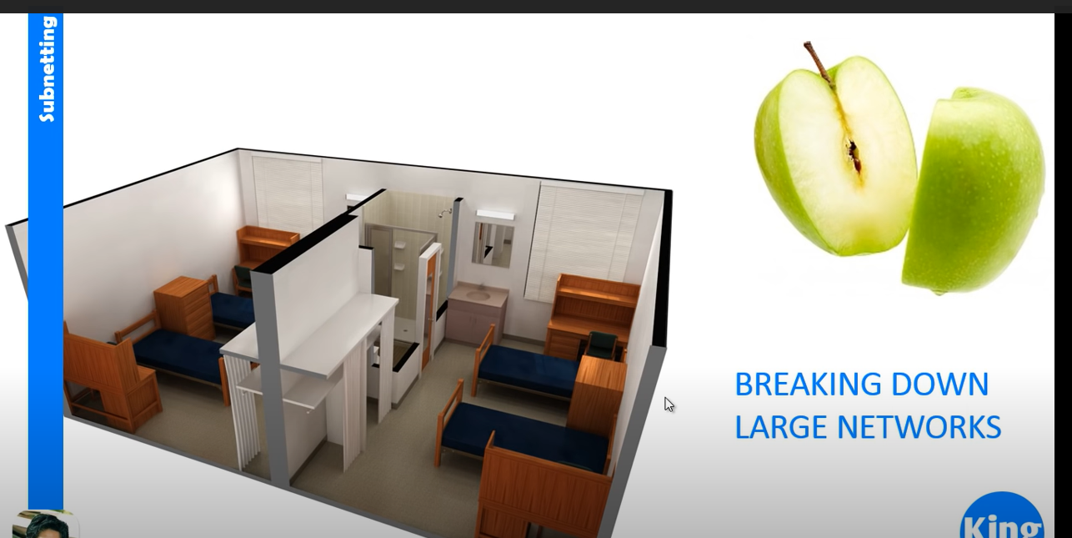

Slide 5
Advantages of subnetting
Enhancing routing efficiency,
Network management control,
Improving network security.
Subnets offer a way of organizing your network to help to reduce network congestion.(Congestion creates problem because in most of the networks we are using hubs rather than switches, so When nodes on a network are connected through a hub, the entire network acts as a single collision domain.)

Slide 6
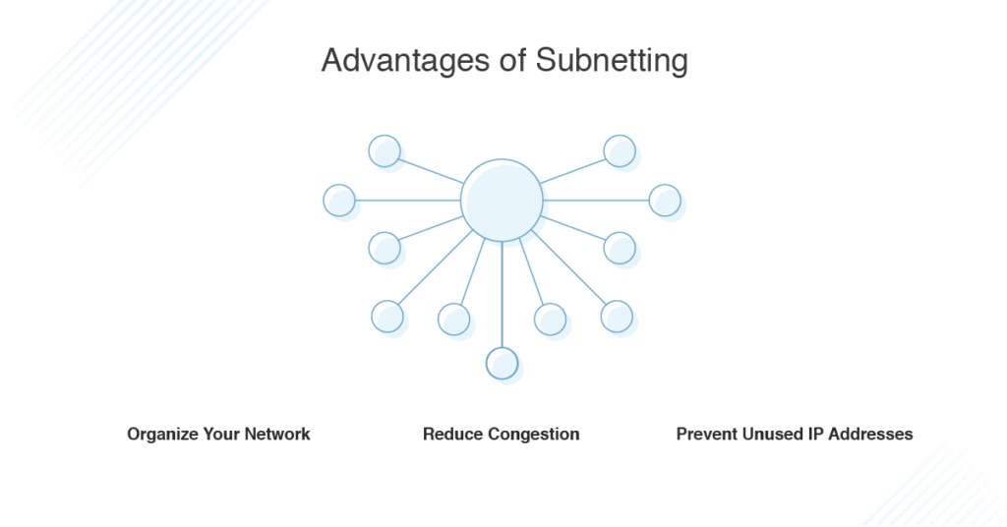

Slide 7
Classless Inter-Domain Routing(CIDR)
CIDR is developed to allocate IP address more efficiently
It is a set of IP that is used to create unique identities for the network and individual devices.
For example: 192.168.100.240/16
This means that the first 16 bits of the IP address given are considered significant for the network routing.
CIDR IP addresses consist of two groups of numbers, which are also referred to as groups of bits. The most important of these groups is the network address, and it is used to identify a network or a sub-network (subnet). The lesser of the bit groups is the host identifier. The host identifier is used to determine which host or device on the network should receive incoming information packets.

Slide 8
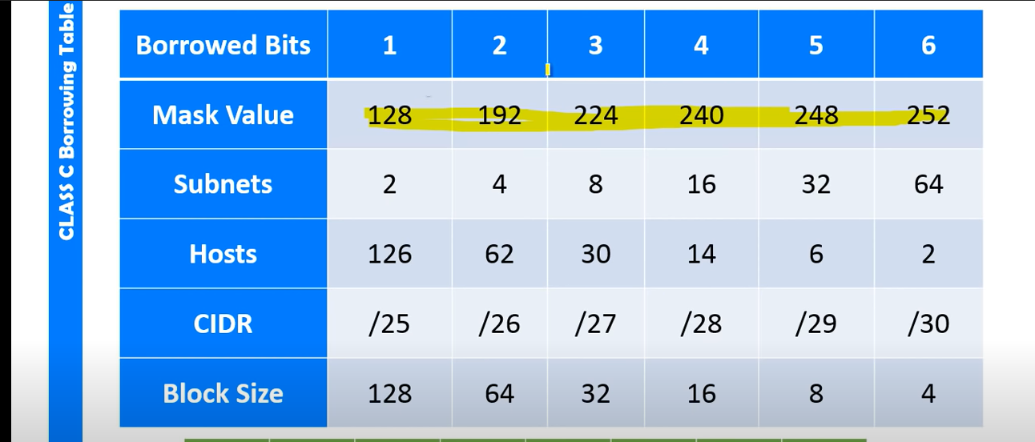

Slide 9
Variable Length Subnetting Mask(VLSM)
VLSM means subnetting a subnet
VLSM stands for Variable Length Subnet Mask where the subnet design uses more than one mask in the same network which means more than one mask is used for different subnets of a single class A, B, C or a network. It is used to increase the usability of subnets as they can be of variable size.

Slide 10
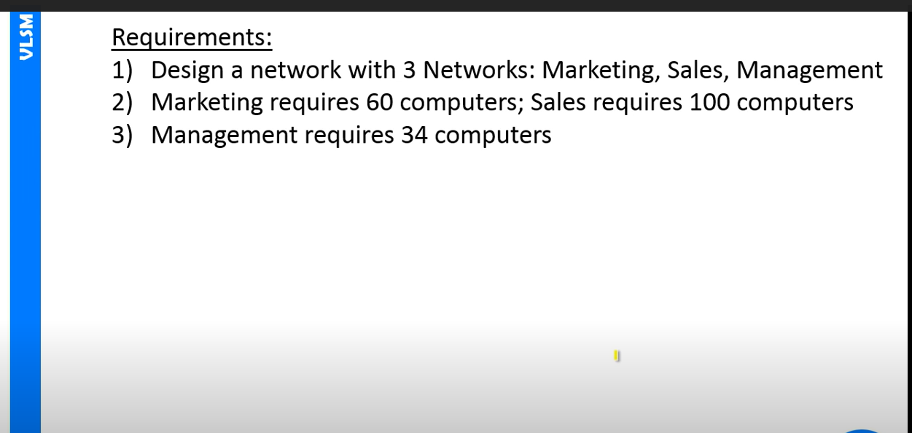

Slide 11
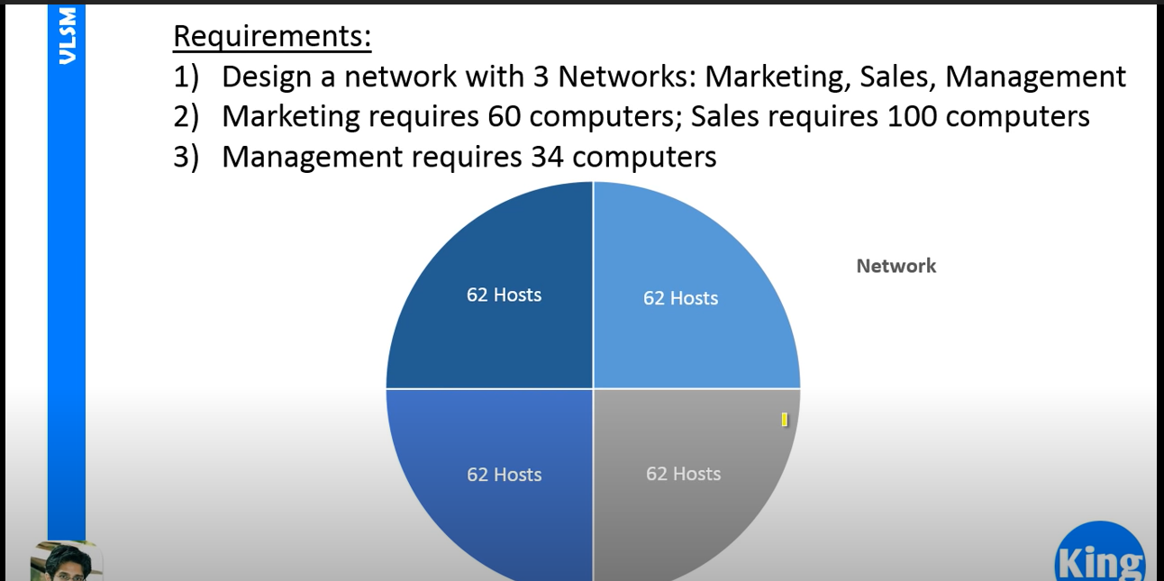

Slide 12
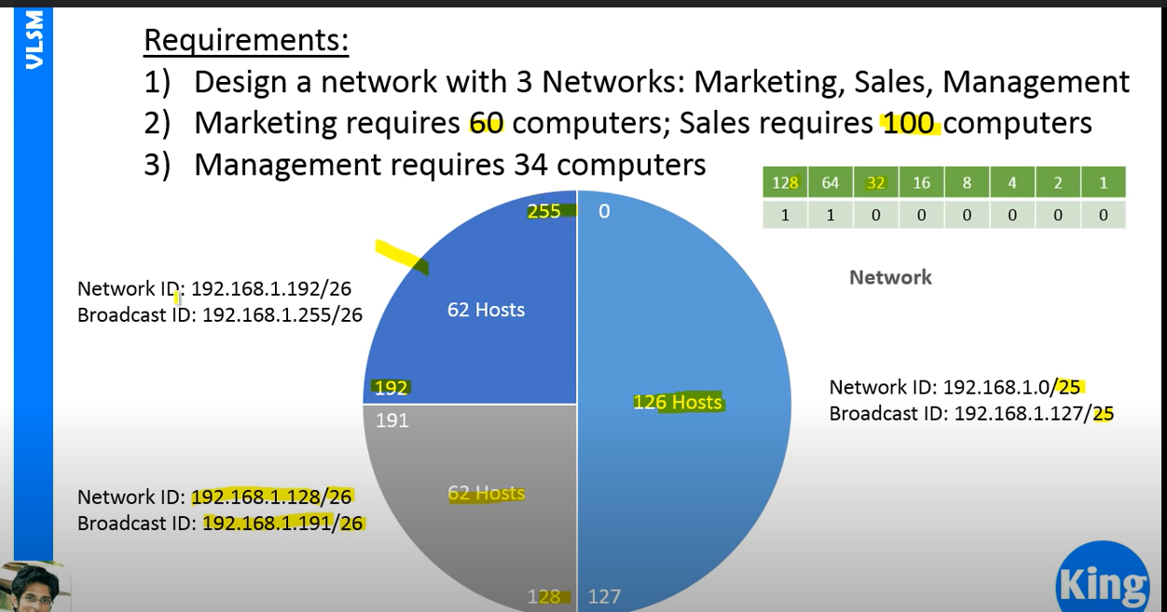

Slide 13
What is SuperNetting?
Supernetting is exact opposite to subnetting
It means the combination of smaller network to make one big network we are using supernetting.

Slide 14
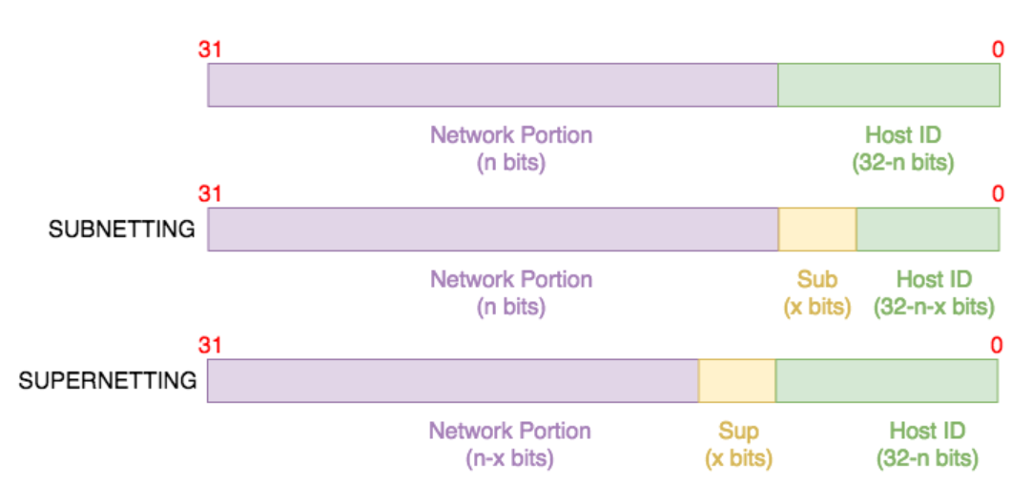
Example of SuperNetting:

Slide 15
Why Supernetting?
The main purpose of supernetting is reducing the size of the routing table on routers.
For example, instead of a router having 8 individual routes, it can have an aggregated route of these 8 individual routes. This is important for several reasons:
It saves memory and processing resources on routing devices.
It need less space to store their routing table
It provides stability on the network i.e. fluctuations can be isolated.

Slide 16
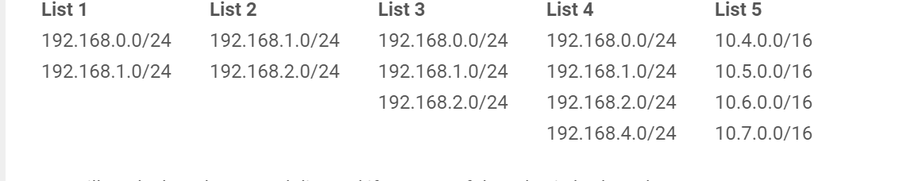
Rules of Supernetting
Rule 1: Contiguous networks
The networks must be contiguous
The networks in List 1 are contiguous because the next subnet after 192.168.0.0/24 is 192.168.1.0/24.

Slide 17
Continued…
Rule 2: Number of networks order of 2
Here List 3 is not of order 2
There are two networks to be aggregated in List 1 which is an order of 2.

Slide 18
Continued…
Rule 3: Value of non-common octet in first IP block is zero or a multiple of the number of networks to be aggregated
The first non-common octet in List 1 is the 3rd octet i.e. 0 vs. 1. The first (lowest) IP address block is 192.168.0.0/24. The decimal value of the 3rd octet in this address block is 0.

Slide 19
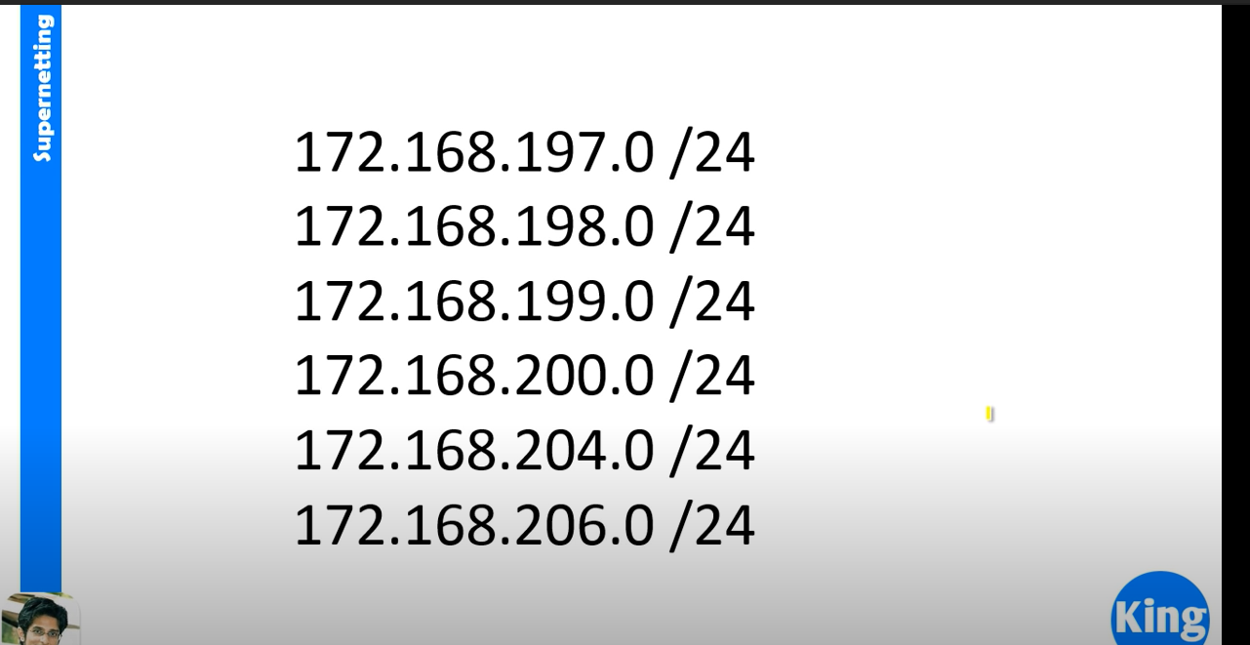
How To do SuperNetting?

Slide 20
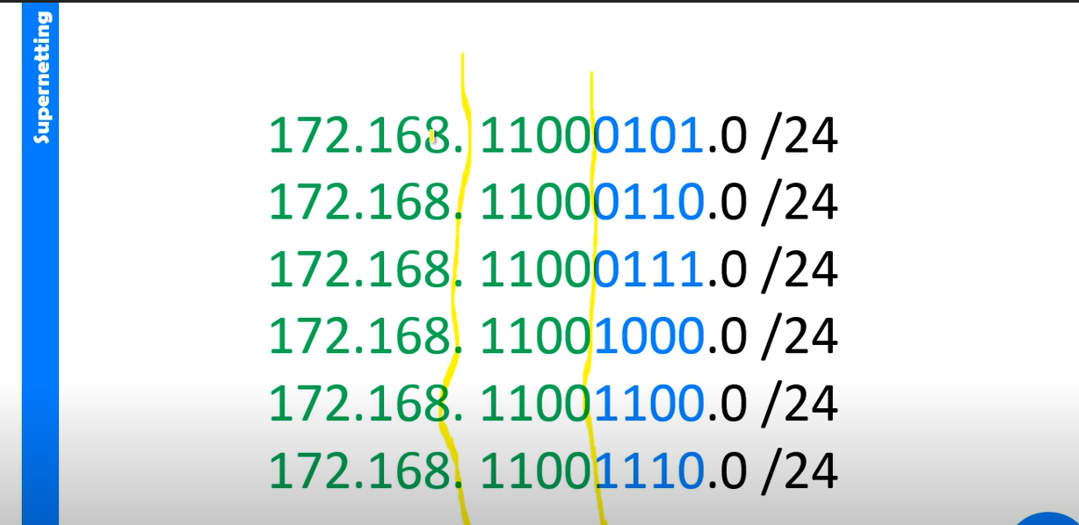

Slide 21
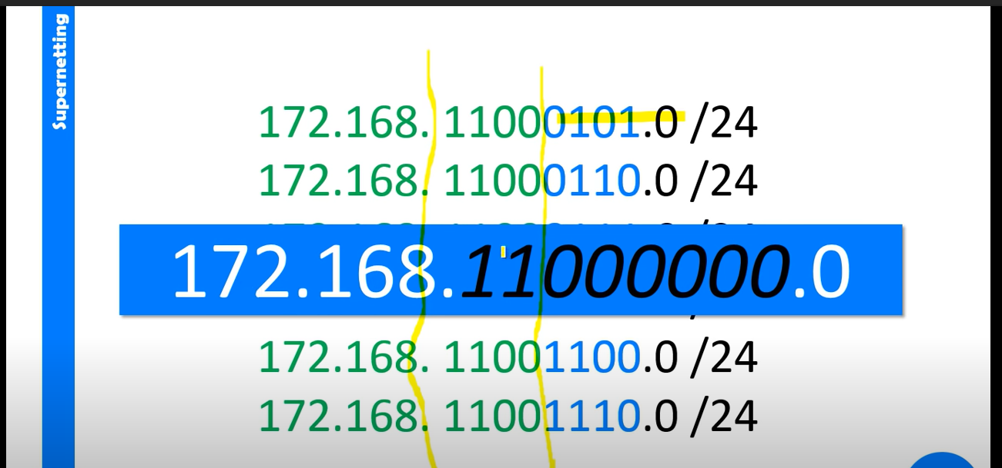

Slide 22
